Slide 1
Video Based Reconstruction of 3D People Models
2018.06.20
Jae-Ryun Chung

Slide 2
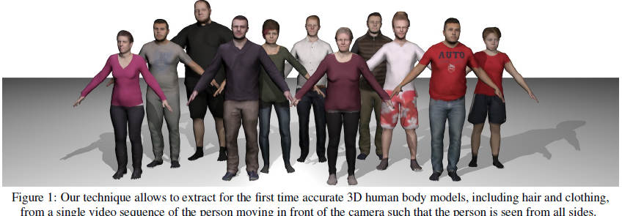
INTRODUCTION
Obtain 3D body model from a single, monocular video
Estimate the shape of people in clothing from a single video in which person moves
Dataset and source code provided[1]

Slide 3
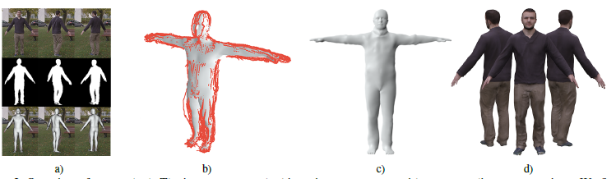
INTRODUCTION
a) Calculate poses using SMPL model
b) Unpose* silhouette camera rays(depicted in red)
c) Optimize for subject shape in T-pose
d) Calculate texture and generate model
Unpose – transform every projection ray according to inverse deformation model of its corresponding 3D model point

Slide 4
Method
Goal is to generate 3D model which consists of body, hair and clothing, texture map and skeleton rigged to surface
3 step
  3.2 Pose reconstruction
    Calculate 3D pose in each frame c.f.)SMPLify
  3.3 Consensus shape estimation
    Optimized to maximally explain silhouettes at each frame instance
  3.4 Frame refinement and texture map generation

Slide 5

3.1 SMPL body model with offsets
SMPL
  72 pose and 10 shape parameters
  Return triangulated mesh with N=6890 vertices
  Shape β and pose θ deformations
  Tμ: training scans
  W: linear blend-skinning function
  T(β,θ): rest pose
  J(β): skeleton joints
  B: shape and pose dependent deformation

Slide 6
3.1 SMPL body model with offsets
SMPL
  Do not include clothing and other personal details
  Add a set of auxiliary variables or offsets D∈R^{3N}
  Offsets are optimized in step 2 (3.3)

Slide 7
3.2 Pose Reconstruction
Output of initialization are SMPL model shape parameter
  Keep fixed during subsequent frame-wise pose estimation
Extend SMPLify
  Jointly considers P=5 frames and optimize a shape and P poses
  Incorporating silhouette term
  I_{rn}(θ): silhouette of rendered model
  C: distance transform of observed image mask
  w: weights
  G: optimized at 4 different level of Gaussian pyramid to be robust to local minima
Output is a set of poses {θ_{p}}^{F}_{p=1} for F frames

Slide 8
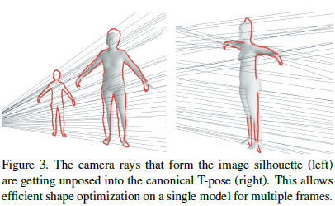

3.3 Consensus Shape
Merged all information into an unposed canonical frame
A set of rays from camera define
a constraint cone
Idea is to unpose the cone
using estimated poses
Invert SMPL function for every ray
SMPL function:
  G_{k}: global transformation of joint k
  b: elements of B corresponding i-th vertex
  v_{i}: vertex input
Every ray r find closest 3D model point

Slide 9

3.3 Consensus Shape
Inverse transformation:
  c.f.)
Given the set of unposed rays for F silhouettes, we formulate an optimization in canonical frame
  Minimize with respect to shape parameters β and vertex offsets D
  Data term and 3 regularization terms with weights

Slide 10


3.3 Consensus Shape
Data Term
  Measure distance between vertices and rays
  Using Plucker coordinates(r = r_{m}, r_{n})
    ρ is Geman-McClure robust cost function
Laplacian Term
  Smooth deformation by adding Laplacian mesh regularizer
    δ=L(v(β₀,0)) and L is the Laplace operator
  Forces Laplacian of optimized mesh to be similar to Laplacian of mesh at initialization

Slide 11


3.3 Consensus Shape
Body Model Term
  Penalize large deviations from shapes explained by SMPL
  Penalize offsets with respect to a template model with offsets D = 0 and an auxiliary variable β~
Symmetry Term
  S: all pairs of Y-symmetric vertices
  Soft-constraint to allow potential symmetries in clothing wrinkles and body shapes

Slide 12
3.3 Consensus Shape
Implementation Details
  Unclothed regions and where silhouettes are noisy are more regularized using per-vertex weights τ
  Optimize E_{cons} using “dog-leg’ trust region method
  Alternate minimizing E_{cons} and finding point to line correspondences
  Re-initialize E_{lp}, E_{var}, E_{sym}

Slide 13
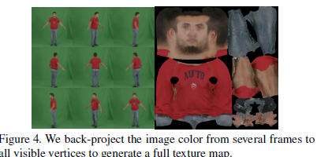

3.4 Frame Refine and Texture Gen.
Aim to capture temporal variations
Adapt Eq. 7 to process frames sequentially
Initialized with preceding frame and regularized with neighboring frames
Ψ_{j}: 1 for j=k and w_{neigh}<1 for neighboring frames
  Defines influence of neighboring frames
E_{last}: regularize reconstruction to result of preceding frame
Warp model back to each frame, back-project image color to all visible vertices and generate texture image

Slide 14
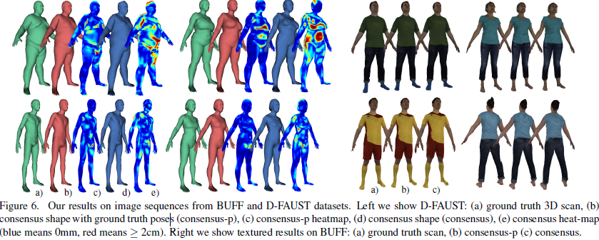
Experiments
BUFF and DynamicFaust
  Created and rotated virtual camera
  300-800frames

Slide 15
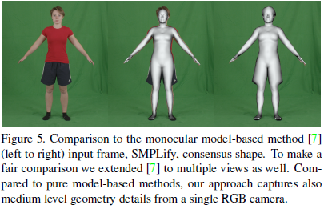
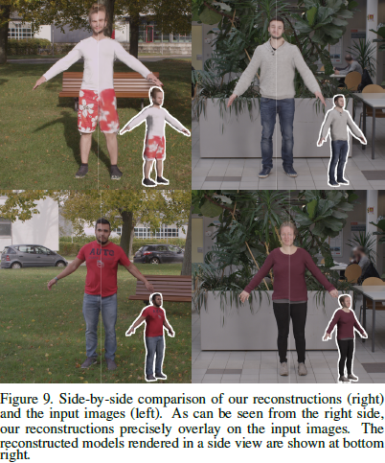
Experiments
Comparision to SMPLify
Overlay the output and input

